Slide 1




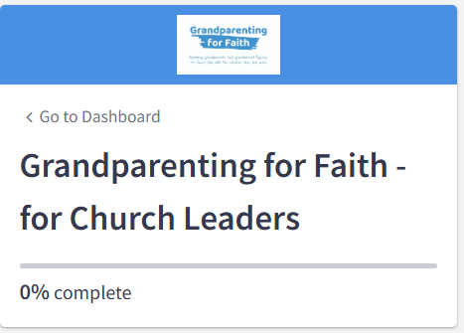

Equipping grandparents and grandparent-figures,
to share God with the children they love most.
Sign up here: https://cym.ac.uk/resourcing

Slide 2
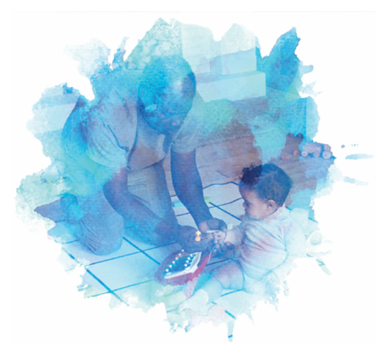
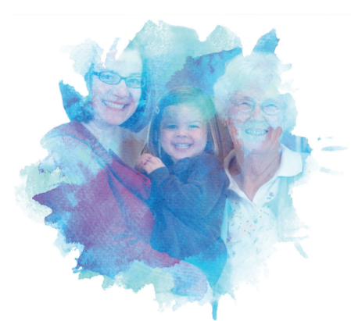
Equipping grandparents and grandparent-figures,
to share God with the children they love most.
You are invited to the Grandparenting for Faith course
Six sessions
Includes video content with Bible-basis, inspiration, encouragement and lots of practical ideas, hints and tips for sharing your faith with the children and young people around you.

Slide 3
Equipping grandparents and grandparent-figures,
to share God with the children they love most.
Some quotes from people who’ve been doing the course already
“I'd been seeking how to better share my faith with my grandchildren. This has energised, informed, and hit the spot”
“I loved hearing the stories of how other grandparents have overcome challenges and issues.”
“It helped us to get to know each other better in church, so that we can support each other more authentically.”

Slide 4
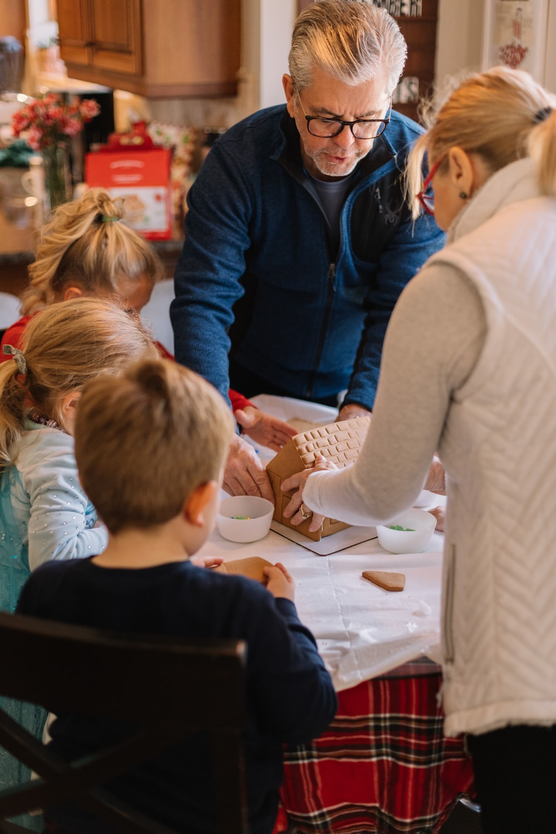
Equipping grandparents and grandparent-figures,
to share God with the children they love most.
These commandments that I give you today are to be on your hearts. Impress them on your children. Talk about them when you sit at home and when you walk along the road, when you lie down and when you get up. Tie them as symbols on your hands and bind them on your foreheads. Write them on the doorframes of your houses and on your gates.
Deuteronomy 6:6-9

Slide 5
Equipping grandparents and grandparent-figures,
to share God with the children they love most.
We will not hide them from their descendants;
we will tell the next generation
the praiseworthy deeds of the Lord,
his power, and the wonders he has done.
Psalm 78:4

Slide 6
Equipping grandparents and grandparent-figures,
to share God with the children they love most.
Each of you is to take up a stone on his shoulder, according to the number of the tribes of the Israelites, to serve as a sign among you. In the future, when your children ask you, ‘What do these stones mean?’ tell them that the flow of the Jordan was cut off before the ark of the covenant of the Lord. When it crossed the Jordan, the waters of the Jordan were cut off. These stones are to be a memorial to the people of Israel forever.”
Joshua 4:4-7

Slide 7
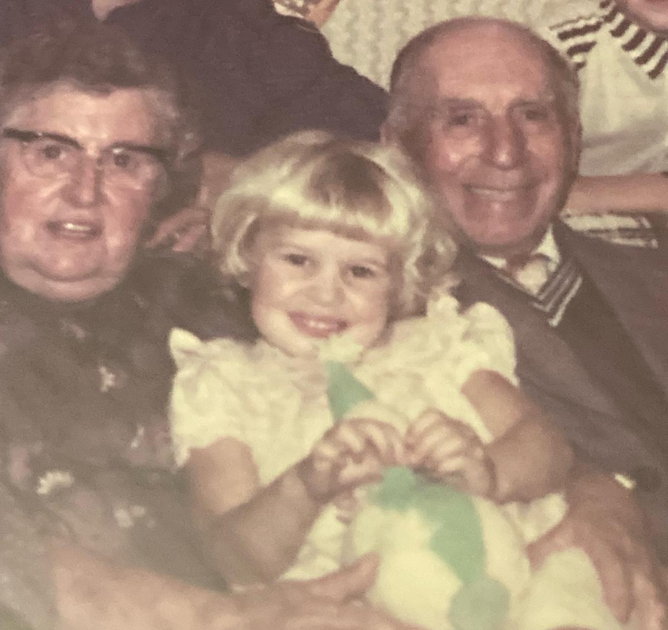

Research amongst Christian grandparents showed a range of experiences…
Some said they felt:
Passive agents, with background involvement
Very involved in discussions about faith
Heritage & foundation of family faith identity
Excluded & uninvolved
Lacked confidence
Uncertain of boundaries
(Holmes, 2022)

Slide 8
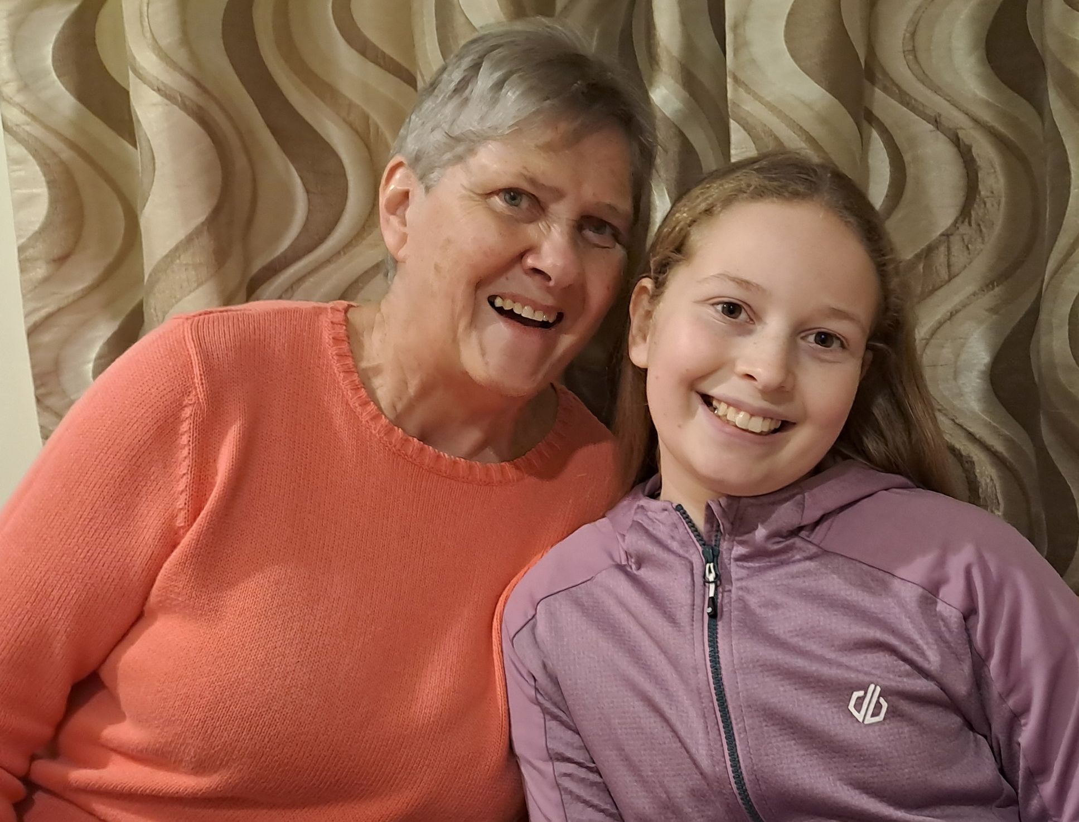
Research showed how some church representatives viewed grandparents
‘walking history’
‘wonderful role models of faith’
‘they have a wealth of life experiences to share’
‘a depth of treasure to share with the church’
> Desire to increase awareness of this worth and potential more widely within local churches and Christian culture.

Slide 9
Research findings of what churches thought may be obstacles for grandparents and grandparent-figures
‘safeguarding puts them off’
‘I think they are a generation who feel that they are not permitted or allowed to’
‘there is often a lot of fear and worry about causing offence’
‘they seem to lack confidence in informal scenarios’
‘they are happy to answer and discuss faith when
asked direct questions but won’t necessarily
instigate it themselves.’

Slide 10
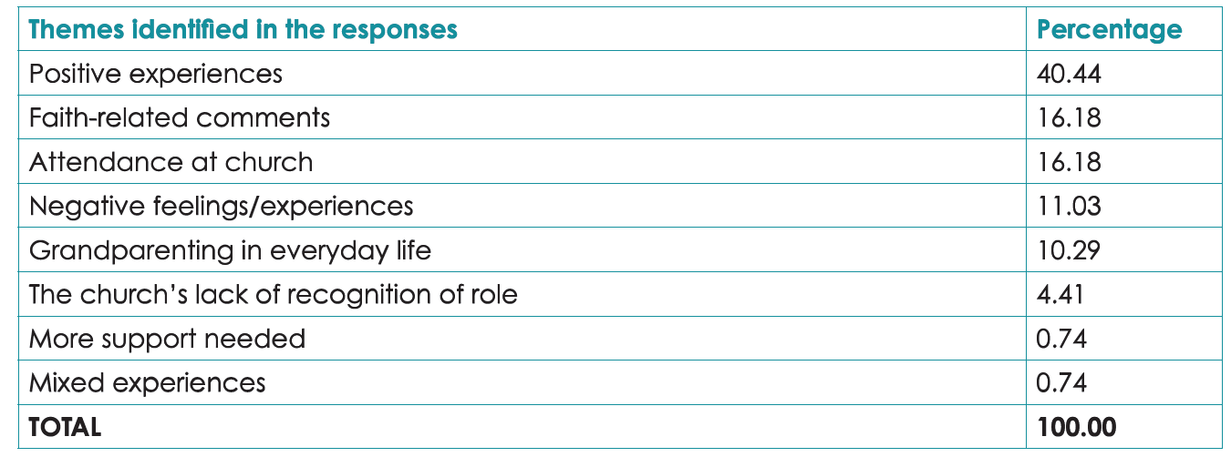

Overall experience of being a grandparent
(Taking the Pulse research, 2024)

Slide 11
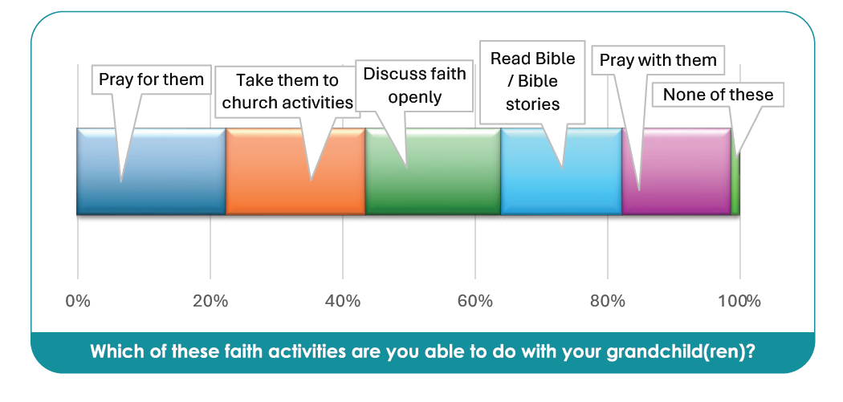
(Taking the Pulse research, 2024)

Slide 12
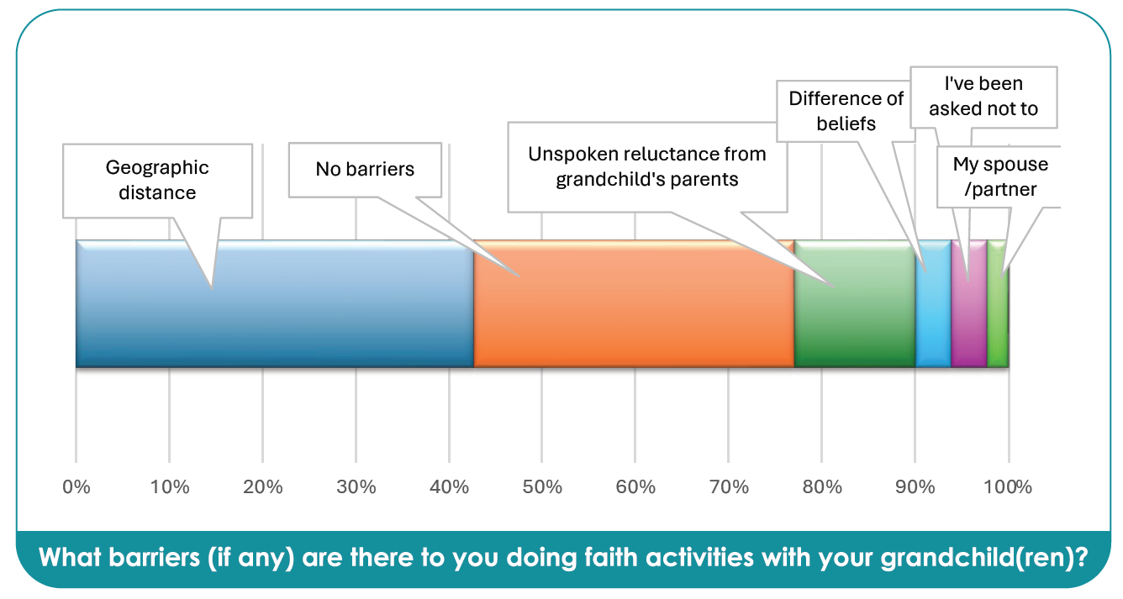
(Taking the Pulse research, 2024)

Slide 13
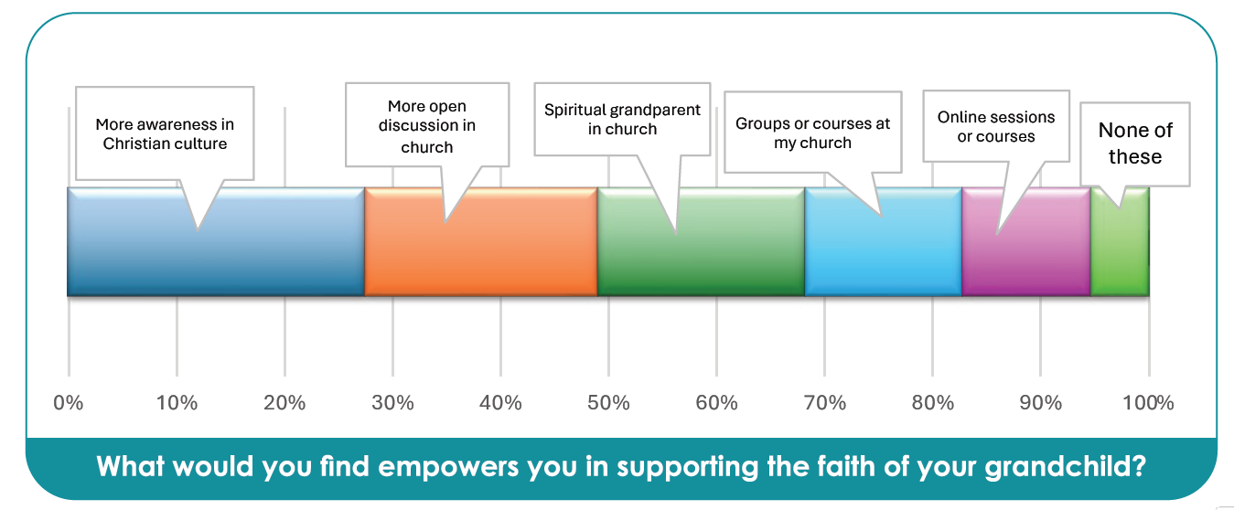
(Taking the Pulse research, 2024)

Slide 14
Equipping grandparents and grandparent-figures,
to share God with the children they love most.
Preliminary findings
This is why Christian grandparents said they have already started doing this course.

